Slide 1

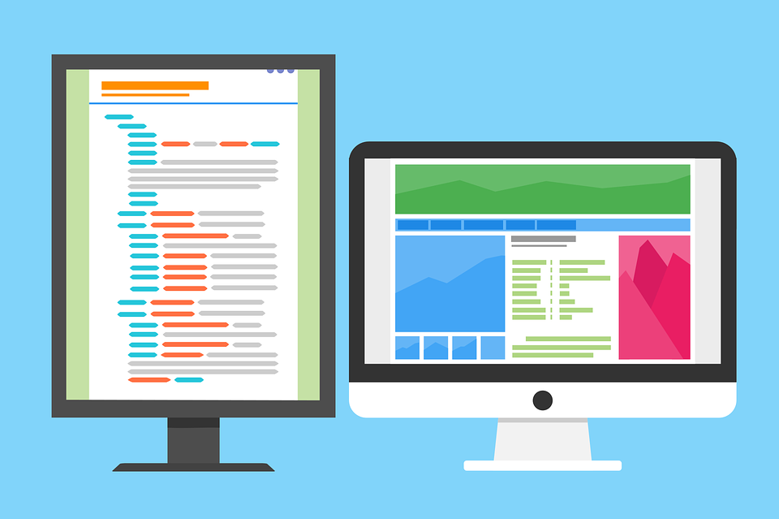

Dictionary in Python
Programming with Ganesh

Slide 2
AGENDA
Programming with Ganesh
What is Dictionary in Python?
Why use a Dictionary Python?
Dictionary Vs List
How to Implement Dictionary in Python?

Slide 3
01
Programming with Ganesh
What Is A Dictionary In Python?

Slide 4
What Is A Dictionary In Python?
Programming with Ganesh
A dictionary is a collection of data types which has key value pairs.
UNORDERED
MUTABLE
INDEXED
NO DUPLICATE MEMBERS

Slide 5
02
Programming with Ganesh
Why Use A Dictionary Python?

Slide 6

Programming with Ganesh
Why Use A Dictionary Python?
Unordered and stores values like map
Contains Key Value pair unlike other data types
Similar to real life dictionary with distinct key values

Slide 7
03
Programming with Ganesh
Dictionary VS List

Slide 8
Programming with Ganesh
Dictionary
Vs
List
Dictionary | List
Unordered | Ordered
Access via keys | Access via index
Collection of key value pairs | Collection of elements
Preferred when you have unique key values | Preferred for order data
No duplicate members | Allow duplicate members

Slide 9
04
Programming with Ganesh
How To Implement Dictionary In Python?

Slide 10
Programming with Ganesh
How To Implement Dictionary In Python?
Dictionary in Python declared inside curly brackets “{}”
mydict={“key1” : “value1”,
“key2” : “value2”,
“key3” : “value3” }
print(mydict)

Slide 11
Thank You

